Slide 1

Experiment 6: Self Driving Car
Navarro, Rod Geryk C.
CPE161P-4– C1

Slide 2
OBJECTIVES
1. To demonstrate how a self driving car works (Forward/Backward).
2. To be able apply what you have learned in logic circuits and switching theory, microprocessors, and CPE160P.
3. To be able to apply real-time embedded system using arduino kit.

Slide 3
DISCUSSION
The system is an IR (Infrared) remote-controlled motor driver, designed to operate a two-motor vehicle based on IR signals received from a remote control. The microcontroller interprets IR signals and executes predefined motor control commands.
Key Components & Functionality:
IR Receiver Module: Connected to pin 8, it receives IR signals and decodes them.
Motor Driver Setup: Two motors are controlled using four motor driver pins. The PWM signals are applied to pins 9 and 10 to regulate motor speed.
IR Signal Processing: The system continuously checks for incoming IR signals. When a valid command is received, it is decoded and processed.
Motor Control Commands:
Move Forward: Both motors rotate forward.
Move Backward : Both motors rotate in reverse.
Turn Left : The left motor stops while the right motor moves forward, allowing a left turn.
Turn Right: The right motor stops while the left motor moves forward, making a right turn.
Stop: Both motors stop.

Slide 4
MATERIALS
Arduino Uno
1 pcs L298N Driver Board Module
1 pcs 18650 Lithium Ion Battery
1 pcs Battery Holder AA 18650 with 4 Slots
1 pcs 3 pin IR Infrared Senor Receiver Module
1 pcs Wireless Remote
1 pcs Chassis
1 pcs Velocimetry Code Wheel
2 pcs Wheel
2 pcs DC Gear Motor
1 pcs Universal Wheel
1 pcs Switch
Laptop

Slide 5
PROCEDURE
Create a working real-time Self Driving Car using Arduino.
To demonstrate the usage of IR sensor, Wireless Remote, Motor Driver Module, Switch, and DC Gear Motors.
Debug the code.

Slide 6
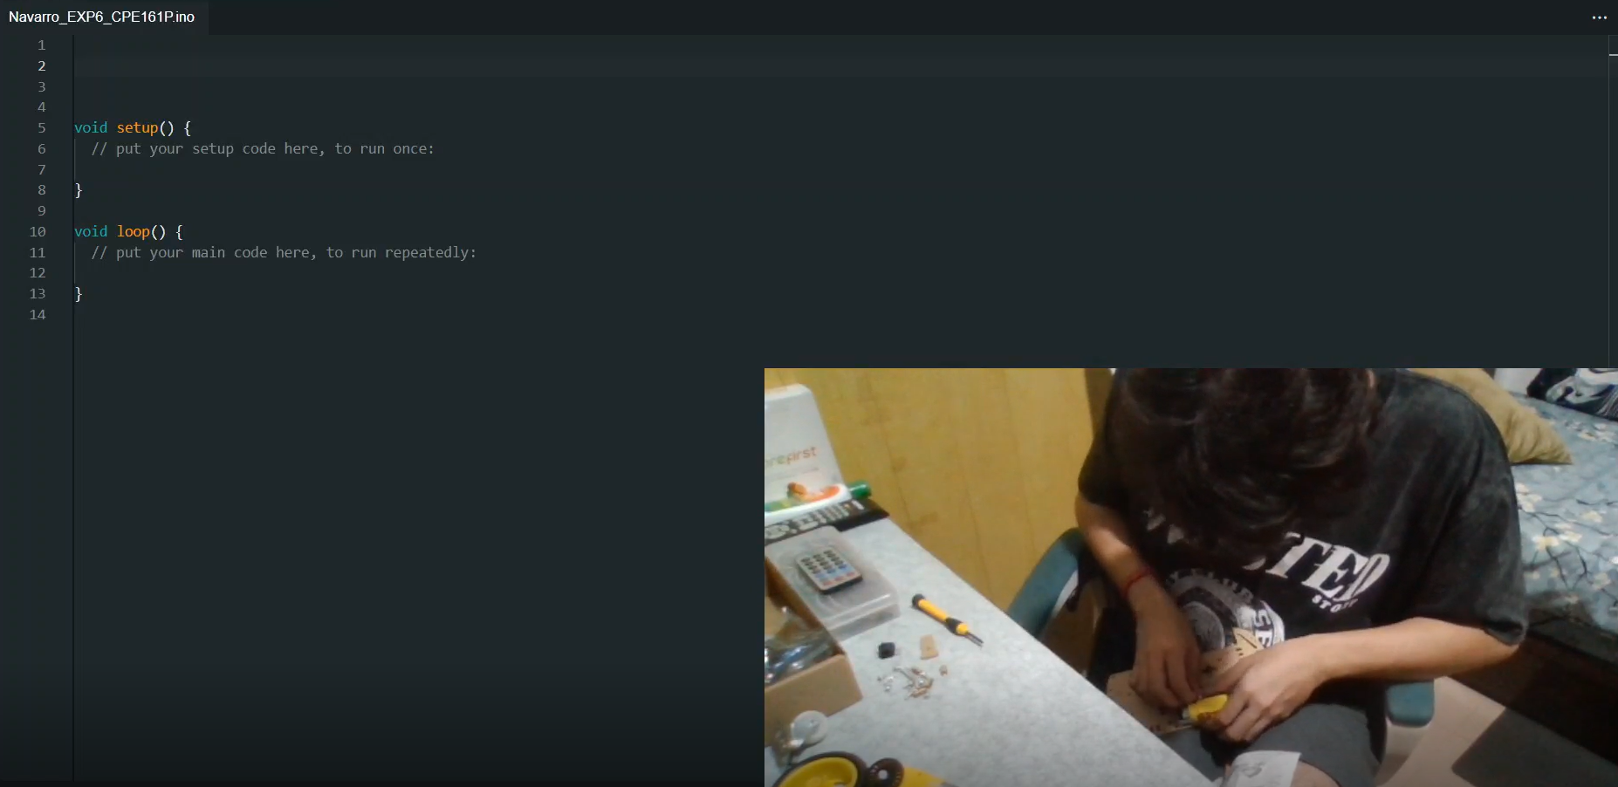
PROCEDURE

Slide 7
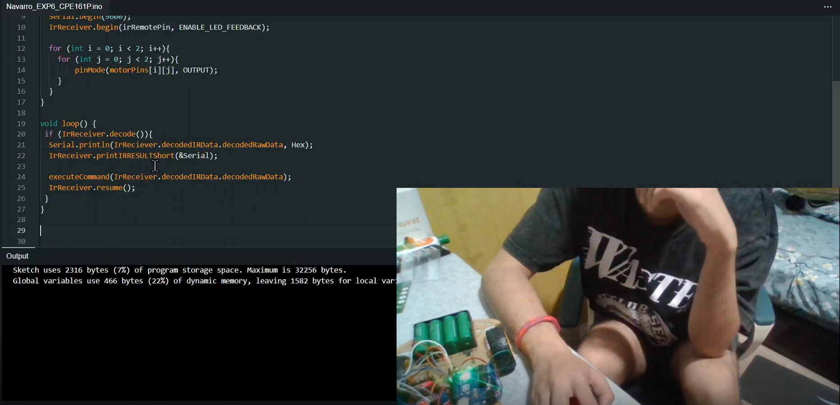
PROCEDURE

Slide 8
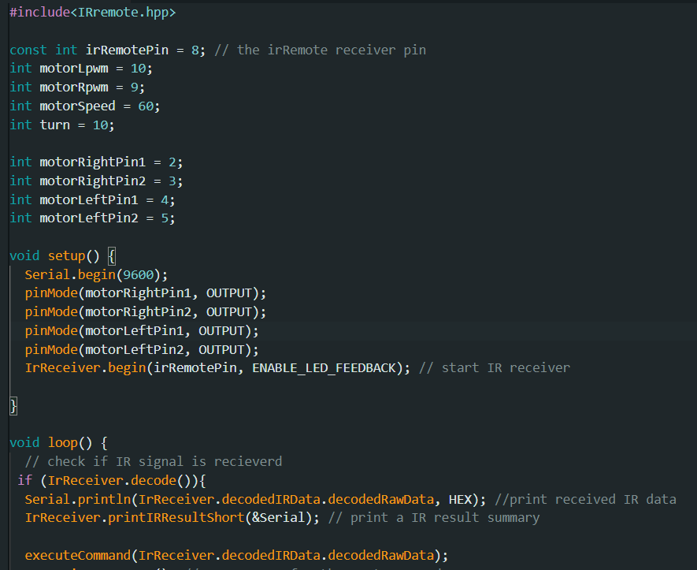
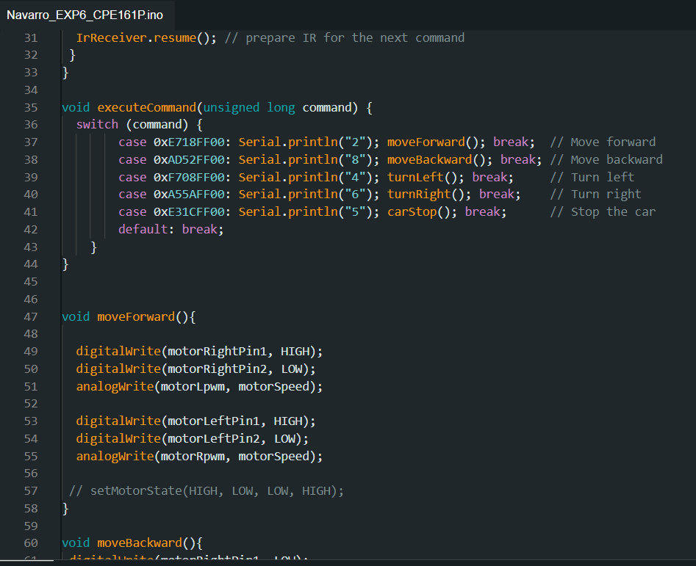
CODE

Slide 9
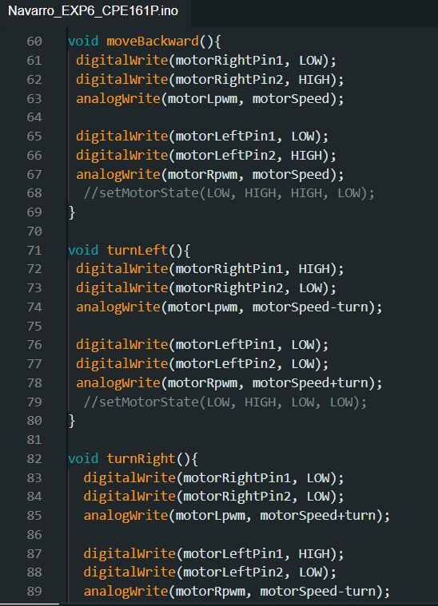
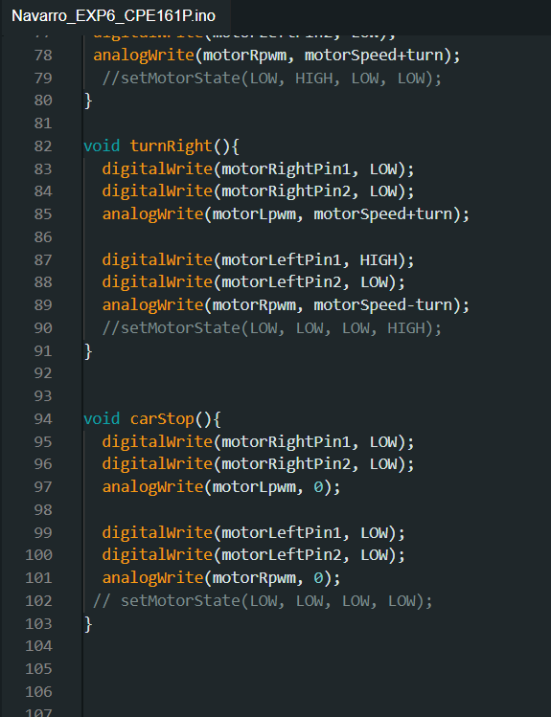
CODE

Slide 10
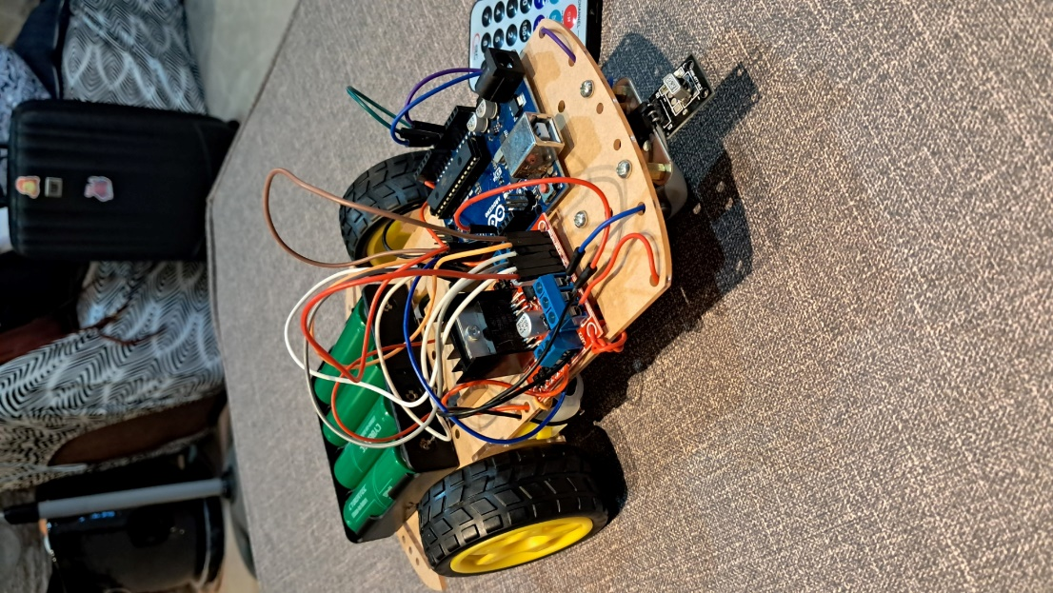
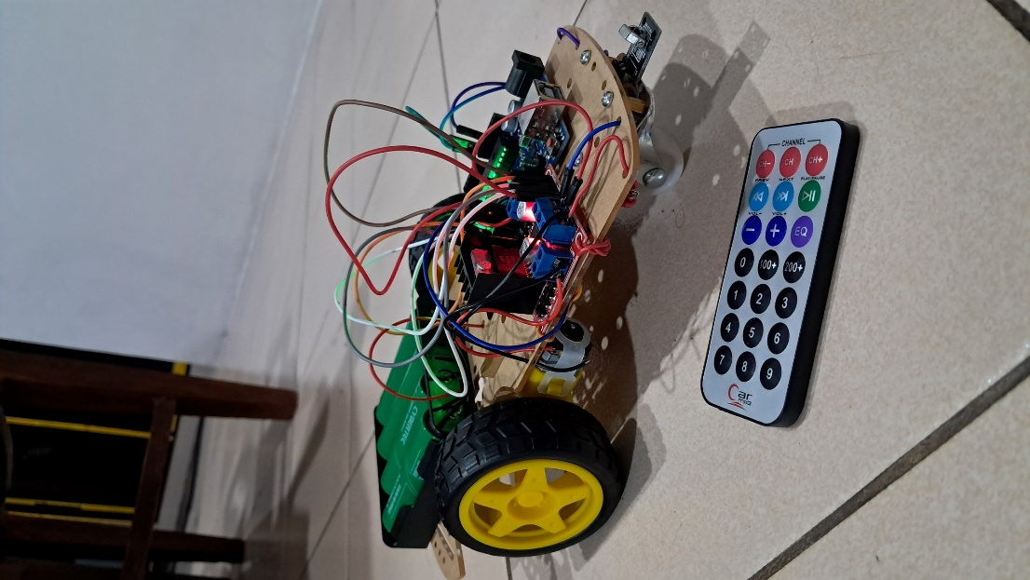
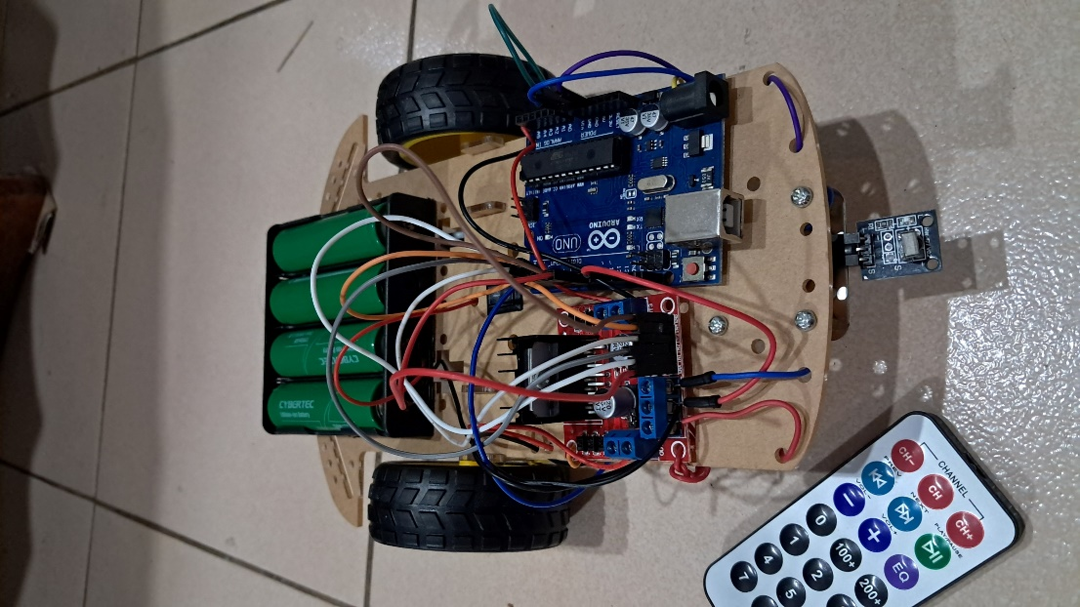
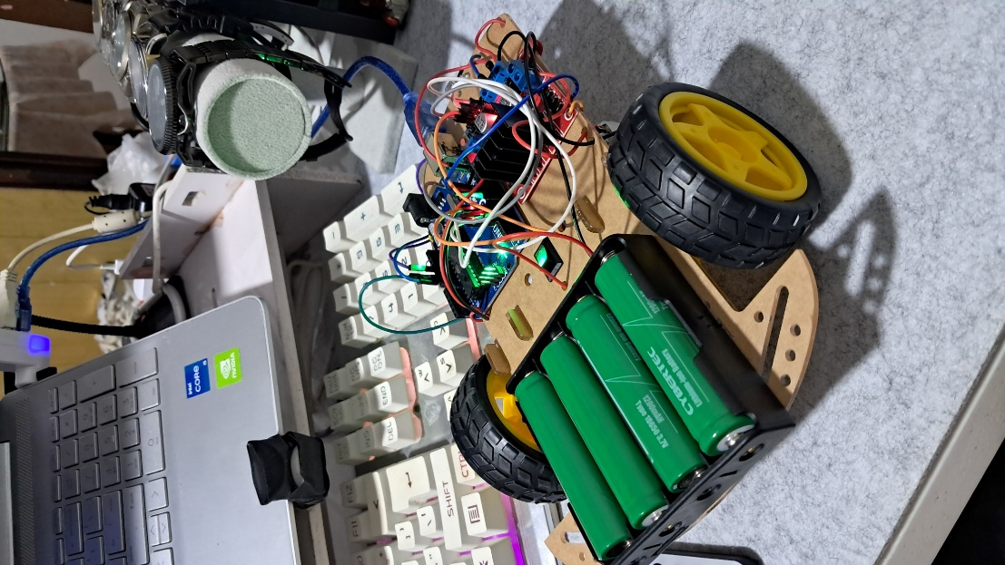
Final Output

Slide 11
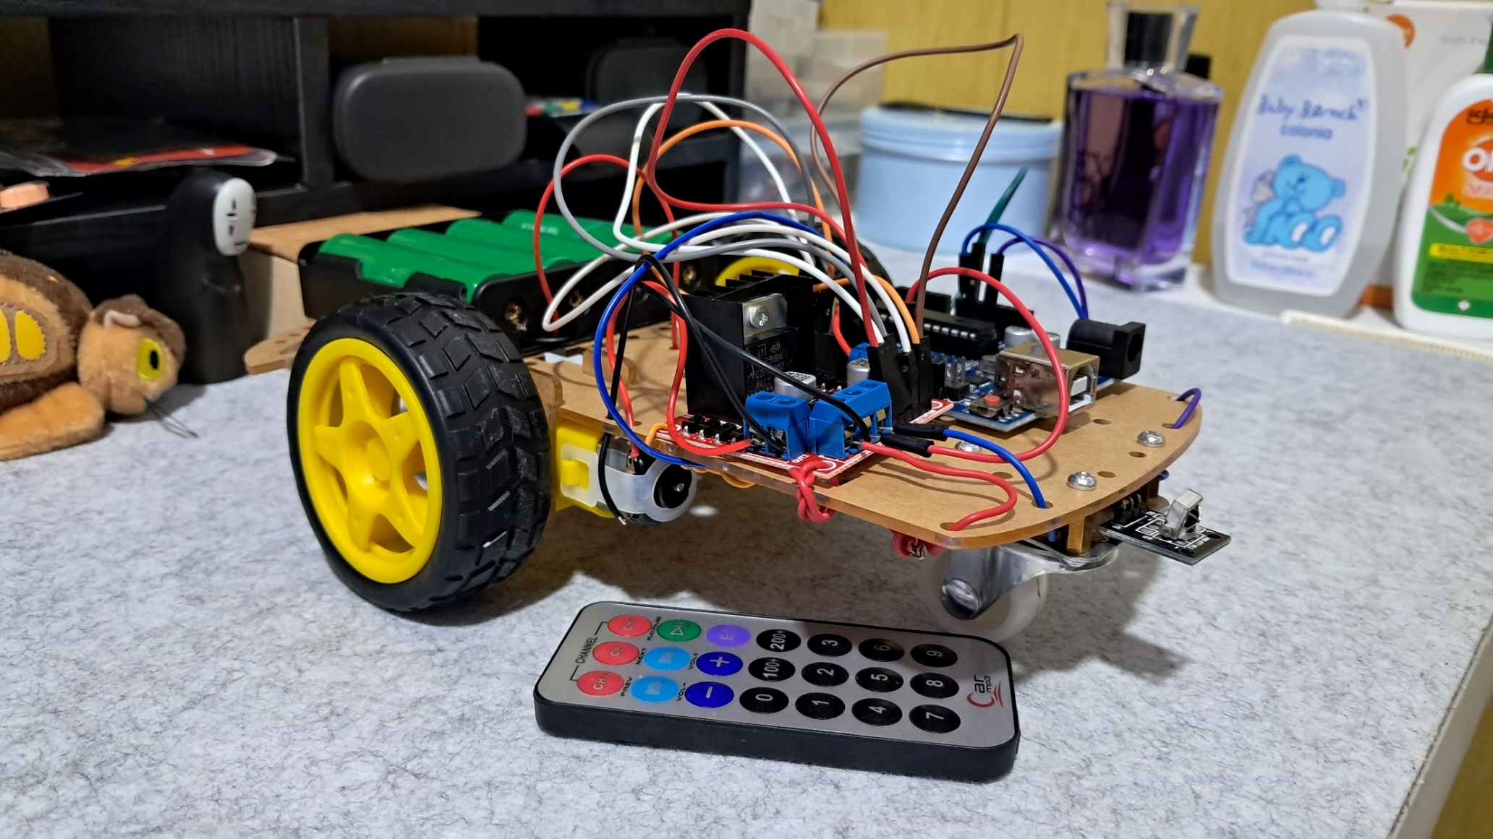
Final Output

Slide 12
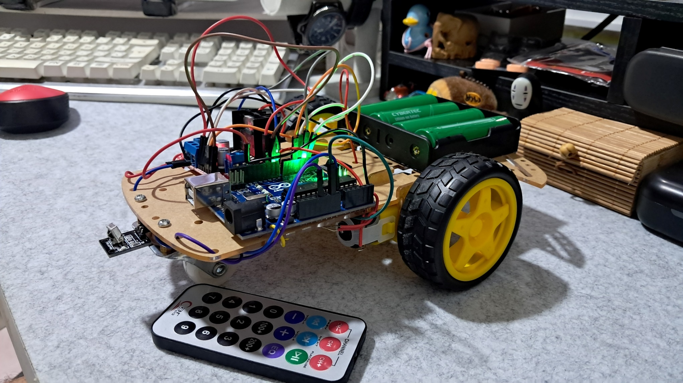
Final Output

Slide 13
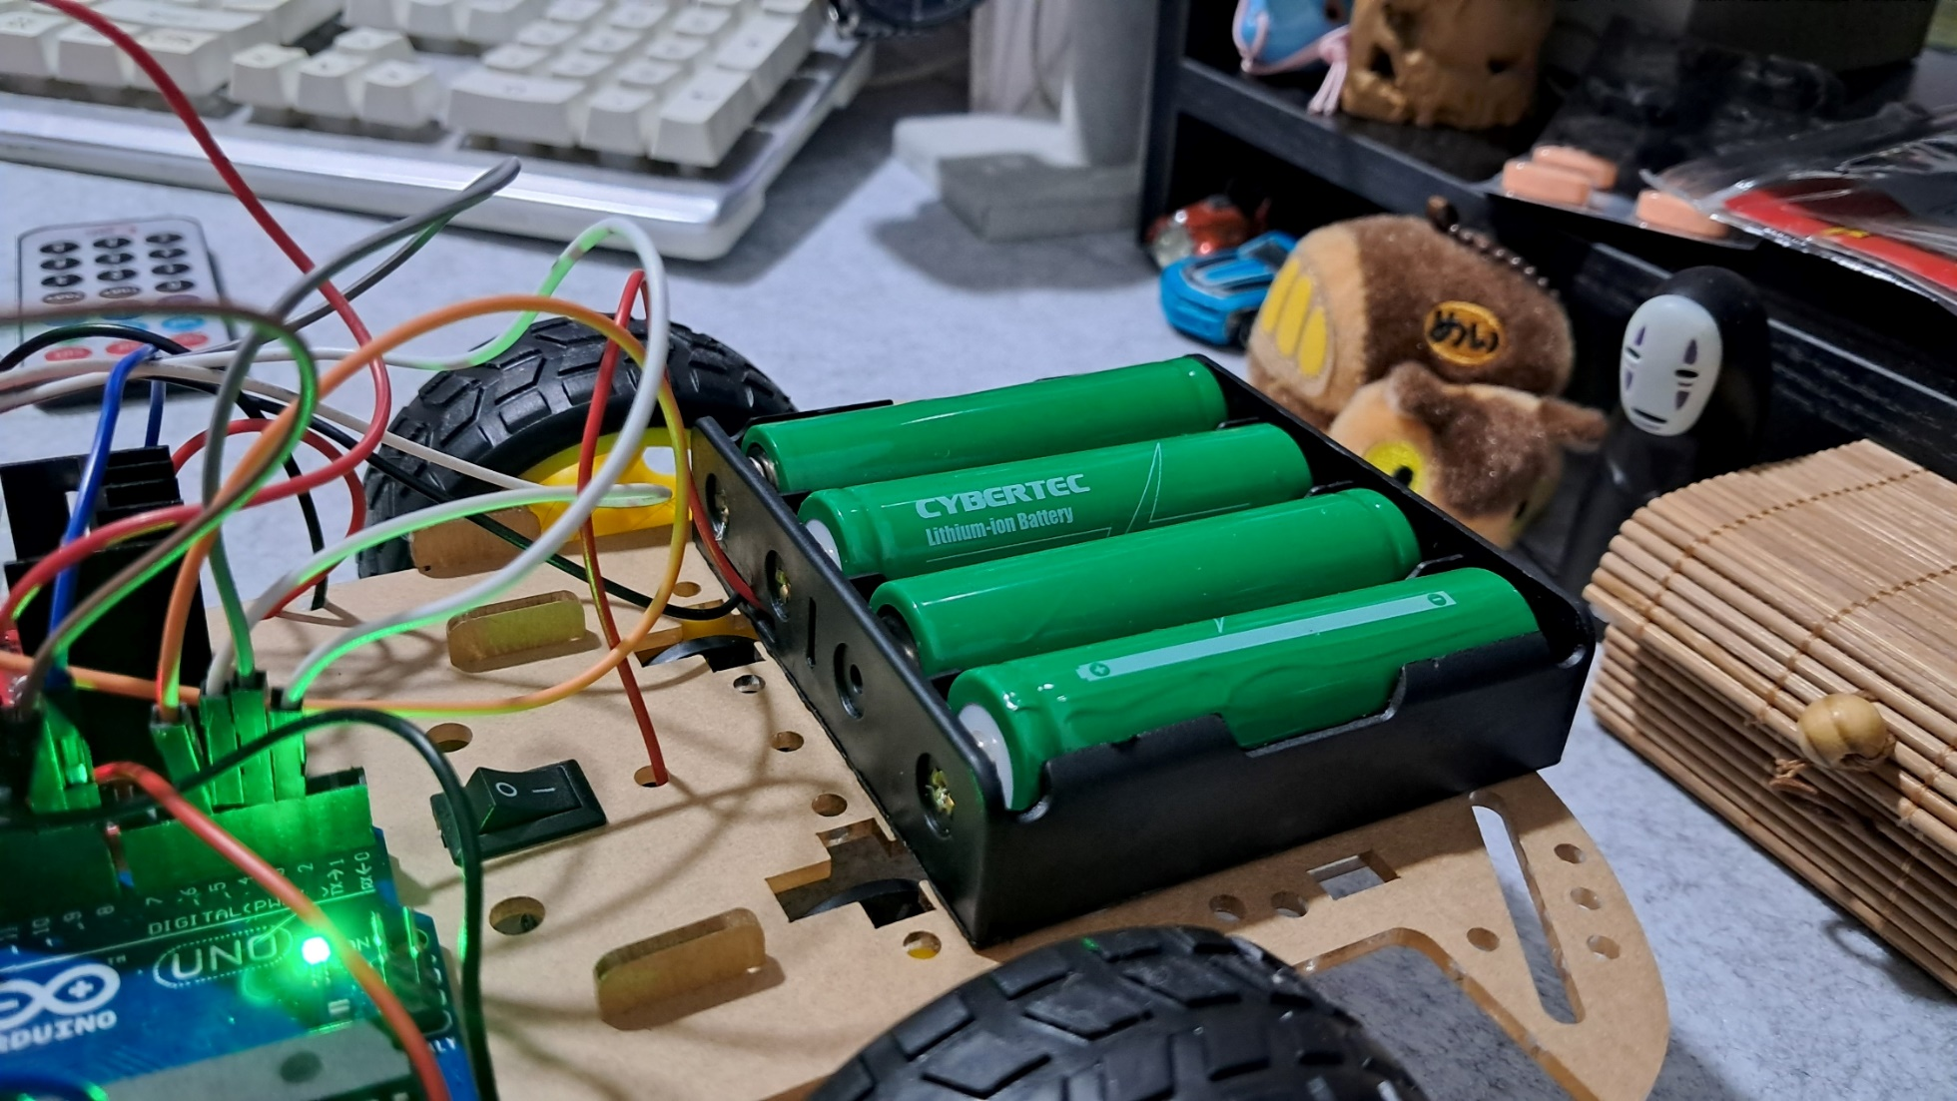
Final Output

Slide 14
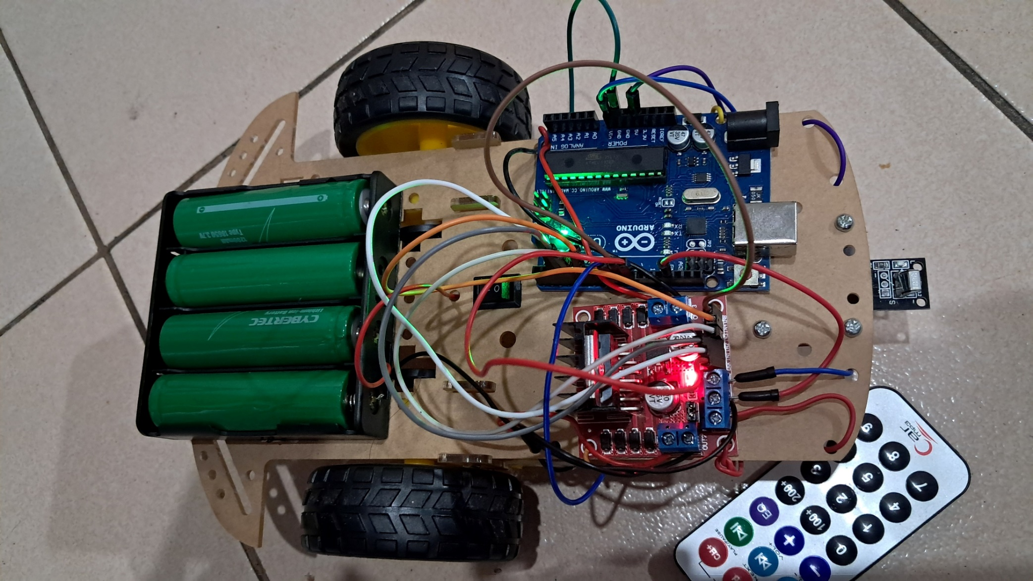
Final Output

Slide 15
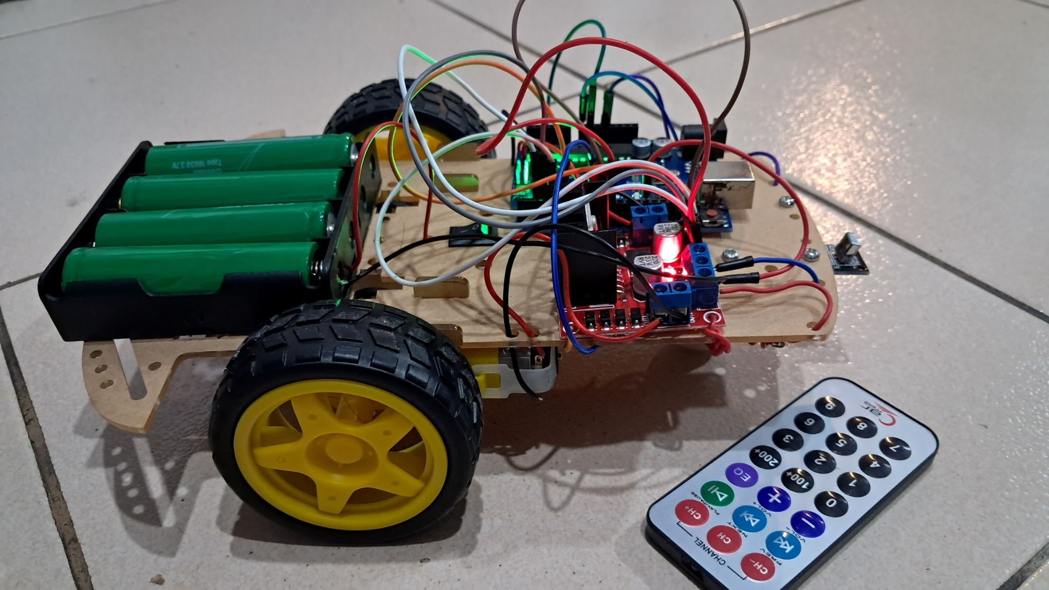
Final Output

Slide 16
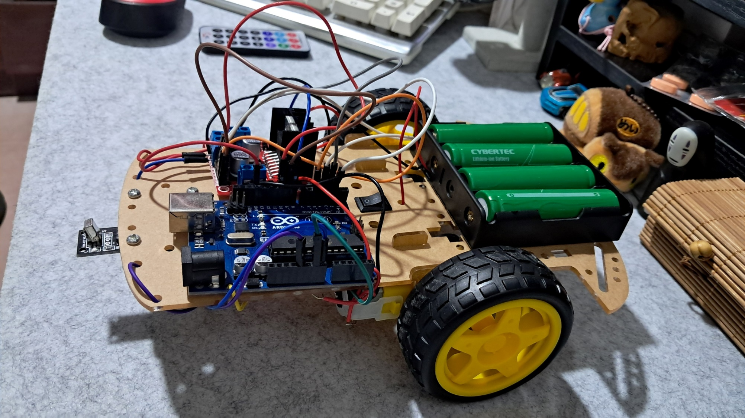
Final Output

Slide 17
THANK YOU!

